Slide 1
ELEVATE YOUR CAREER
WITH ACI MEMBERSHIP

Slide 2
What is ACI?

Slide 3
Founded in 1904
Headquartered in Michigan
Membership-driven nonprofit
Develops and disseminates consensus based knowledge on concrete and its uses.

Slide 4
nearly
20,000 Members

Slide 5
in

Slide 7
Engineers
Educators
Contractors
Architects
Students
Technicians

Slide 8
What are the benefits to becoming a member?
Notes:
History

Slide 9
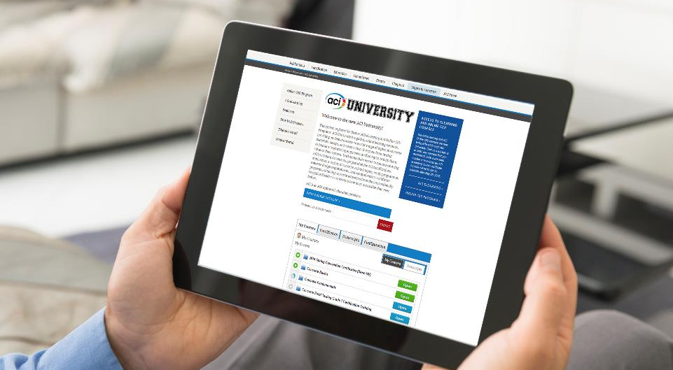
.Com
Earn CEUs
100+ Concrete topics
Download documents
Watch webinars

Slide 10
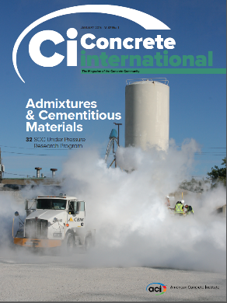
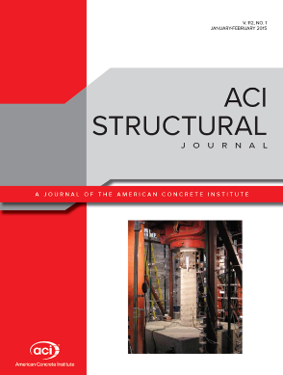
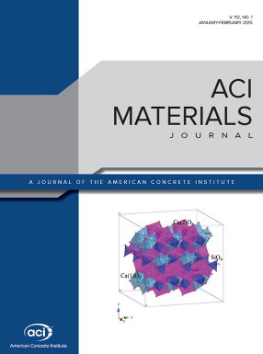
FREE Industry Publications

Slide 11
www.Concrete.org/CareerCenter

Slide 12
Networking
2 Annual Conventions
60+ Seminars
130 Technical Committees

Slide 15
Individual
Young Professional
FREE
Student
Membership
Organizational
Sustaining
Member

Slide 16
KNOWLEDGE NETWORKING DISCOUNTS
Take Your Career To The Next Level

