Slide 1
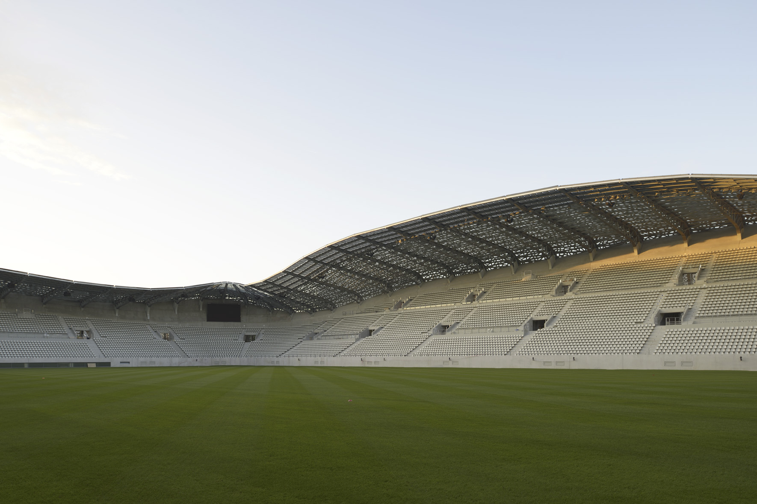
A Few Moments About the American Concrete Institute
Notes:
These slides are meant to be used as a tool to help you articulate the vision and select programs/services of the American Concrete Institute. The speaker’s notes are intended to be a guide for your remarks, and should be customized to suit your comfort and presentation style. For additional content about ACI and its programs/services to be used in your slides, or for additional help in generating/customizing your presentation, please contact:
Cameron Innis
Marketing Coordinator
American Concrete Institute
1.248.848.3147 | Cameron.Innis@concrete.org

Slide 2
ACI envisions a future where everyone has the knowledge needed to use concrete effectively to meet the demands of a changing world.
* * * * *
ACI develops and disseminates consensus-based knowledge on concrete and its uses.
Notes:
ACI envisions a future where everyone has the knowledge needed to use concrete effectively to meet the demands of a changing world. To accomplish this, ACI develops and disseminates consensus-based knowledge on concrete and its uses.

Slide 3
About ACI
Founded in 1904 and headquartered in Farmington Hills, Michigan, USA. ACI is a leading authority for the development of:
Consensus based standards
Technical resources
Educational programs
Design
Construction and;
Materials
ACI is committed to the development and distribution of the best practices of concrete
Notes:
Founded in 1904 and headquartered in Farmington Hills, Michigan, USA, the American Concrete Institute is a leading authority and resource worldwide for the development and distribution of consensus-based standards, technical resources, educational programs, and proven expertise for individuals and organizations involved in concrete design, construction, and materials, who share a commitment to pursuing the best use of concrete.

Slide 4





Documents
Membership
ACI Foundation
ACI University
Certification
Notes:
The American Concrete Institute is an organization of individuals dedicated to the best use of concrete. These individuals are members of the Institute, network with each other in person and digitally, attend ACI conventions held twice annually, and participate in and lead ACI’s global network of chapters.
Developing consensus-based knowledge on concrete and its uses is the reason most individuals seek out and contribute to ACI’s vast knowledge. By publishing digital and printed editions of hundreds of technical document/publications, a monthly magazine Concrete International, and two bi-monthly Journals, the Institute shares its consensus-based knowledge with the global concrete community. And, interestingly, all of these technical resources, as well as resources from dozens of similar international institutes, are accessible through www.concrete.org.
Since 1980, ACI has certified over 400,000 individuals through its certification program. From popular programs such as Flatwork Finisher and Field Testing Technician, to specialty programs such as Adhesive Anchor Installer, Concrete Construction Special Inspector, and the new Masonry Testing Technician programs, ACI certification provides a minimum qualification for personnel employed within the concrete construction industry.
ACI University combines all of ACI's online educational offerings in one location and makes them more convenient to access, even on mobile devices. With this immediate access to courses covering ACI's technical documents, preparation for ACI certifications, webinars on a variety of concrete-related topics, and study programs on concrete design requirements, concrete professionals can obtain education from an internationally recognized leader in a more easily accessible manner than ever before.
The ACI Foundation is a not-for-profit organization established by the American Concrete Institute to promote progress, innovation, and collaboration by supporting research and scholarships, while also serving as an independent resource to provide thought leadership and strategic direction for the concrete industry.

Slide 5
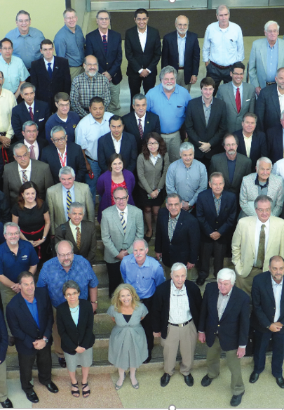
An Institute of Members & Chapters
Over 18,000 Institute members from 120 countries
Plus about 20,000 members from ACI’s 200+ Chapters and Student Chapters
Notes:
ACI’s inclusive, member-driven structure and valuable, cost-effective benefits result in an essential organization that invites partnerships and welcomes all concrete professionals who wish to be part of a respected, connected, social group that provides an opportunity for professional growth, networking and enjoyment. The American Concrete Institute is an organization of individuals dedicated to the best use of concrete. The Institute is fortunate to share knowledge with and learn from over 18,000 Institute members, plus an additional 20,000 members of ACI’s local chapters. The composition of ACI membership is as diverse demographically as it is geographically, representing many, many concrete related fields with members in 120 countries worldwide – if you aren’t a member, I encourage you to look into our Institute.
And, if you know any students studying in concrete and engineering fields, student membership is completely free!

Slide 6
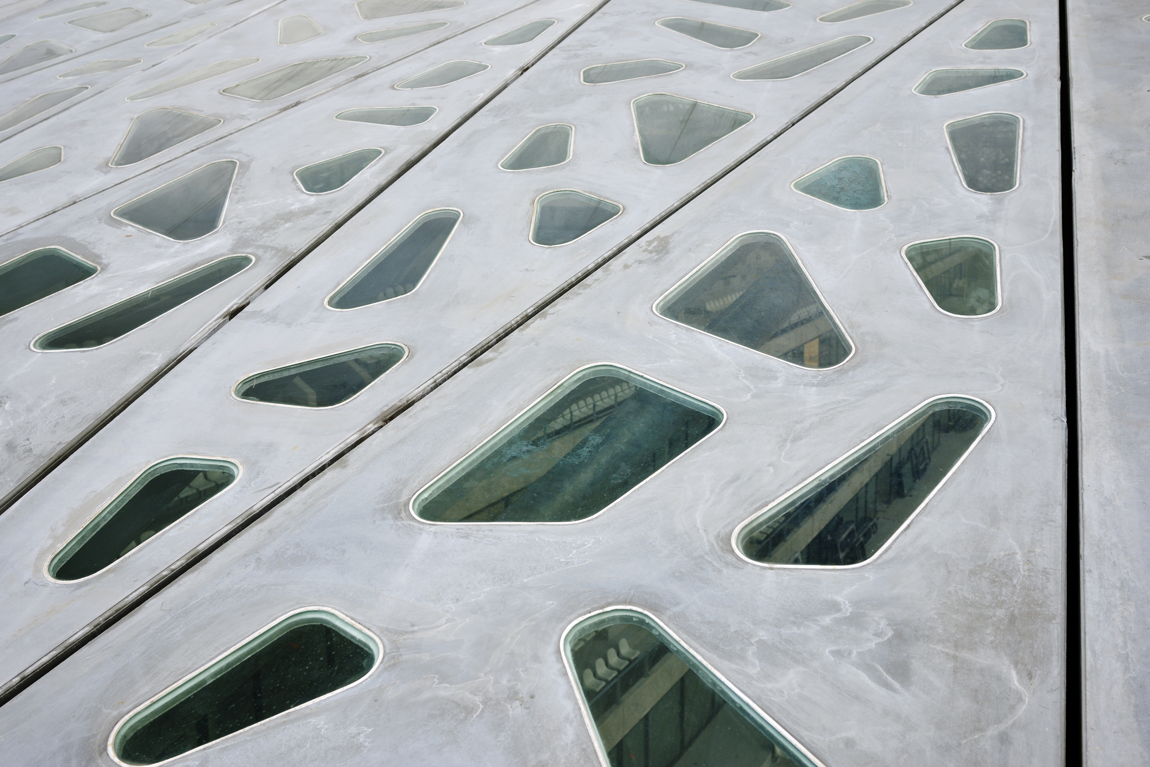
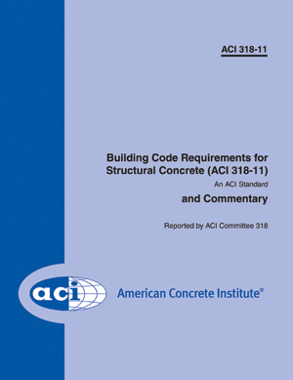
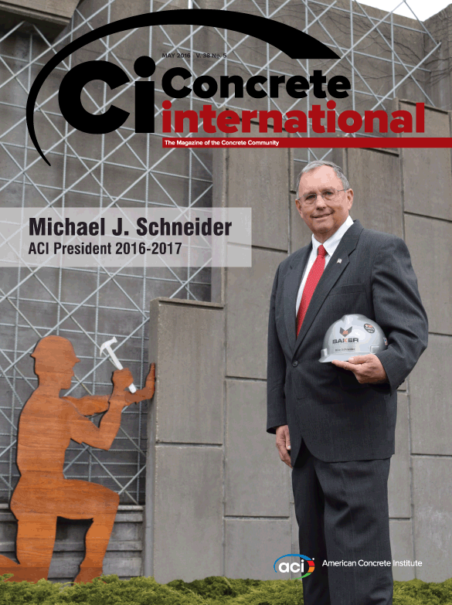
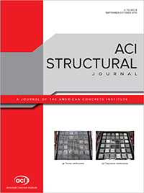
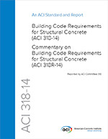
ACI Documents
ACI online and print resources include:
Technical documents
Handbooks
Manuals
Certification
Educational publications
Concrete International, and
Two bi-monthly journals
Notes:
ACI produces hundreds of documents dedicated to improving the design, construction, maintenance, and repair of concrete and masonry structures. ACI online and print resources include technical documents, certification, and educational publications, as well as handbooks and manuals. ACI also produces two bi-monthly technical journals—the ACI Materials Journal and the ACI Structural Journal. Concrete Internationalis a monthly magazine for professionals interested in concrete. The magazine features articles, news, and information about current trends in the industry.

Slide 7

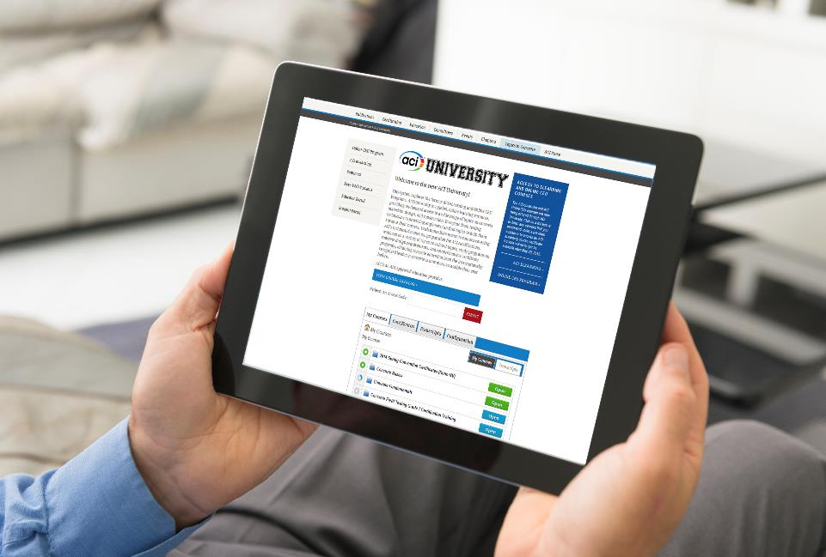


Concrete Fundamentals
Concrete Strength Testing
Technician Certification Training
Tolerance Compatibility
And MORE!
ACIUniversity.com
Notes:
ACI University is a global, online learning resource, providing on-demand access to a wide range of topics on concrete materials, design, and construction. Everyone from testing technicians to practicing engineers can find topics to help them advance their careers. With immediate access to courses covering ACI’s technical documents, preparation for ACI certifications, webinars on a variety of concrete-related topics, study programs on concrete design requirements, and comprehensive certificate programs, obtaining concrete education from the internationally recognized leader in concrete is now more accessible than ever before.

Slide 8


Strategic Development Council
Concrete Research Council
Committed to resolving the issues of new technology acceptance within the concrete industry
Funds and assists in the research of new concrete technologies
Scholarship Council
Facilitates student fellowships and scholarships
ACIFoundation.org
@ACIFoundation
Notes:
The ACI Foundation is a wholly owned and operated non-profit subsidiary of the American Concrete Institute. Three councils make up the ACI Foundation; the Strategic Development Council, committed to resolving the issues of new technology acceptance within the concrete industry; the Concrete Research Council, which funds and assists in the research of new concrete technologies; and the Scholarship Council which facilitates student fellowships and scholarships. More information about the ACI Foundation can be found by visiting its website: www.ACIFoundation.org.

Slide 9
Certification Training & Exams
Laboratory
Technician
Field
Technician
20 Programs
Offered in English, French, Spanish and Chinese
Tilt-Up
Shotcrete
Nozzleman
Craftsman
And More!
Notes:
Since 1980, ACI has certified over 400,000 individuals through its certification program. From popular programs such as Flatwork Finisher and Field Testing Technician, to specialty programs such as Adhesive Anchor Installer, Concrete Construction Special Inspector, and the new Masonry Testing Technician programs, ACI certification provides a minimum qualification for personnel employed within the concrete construction industry.

Slide 10
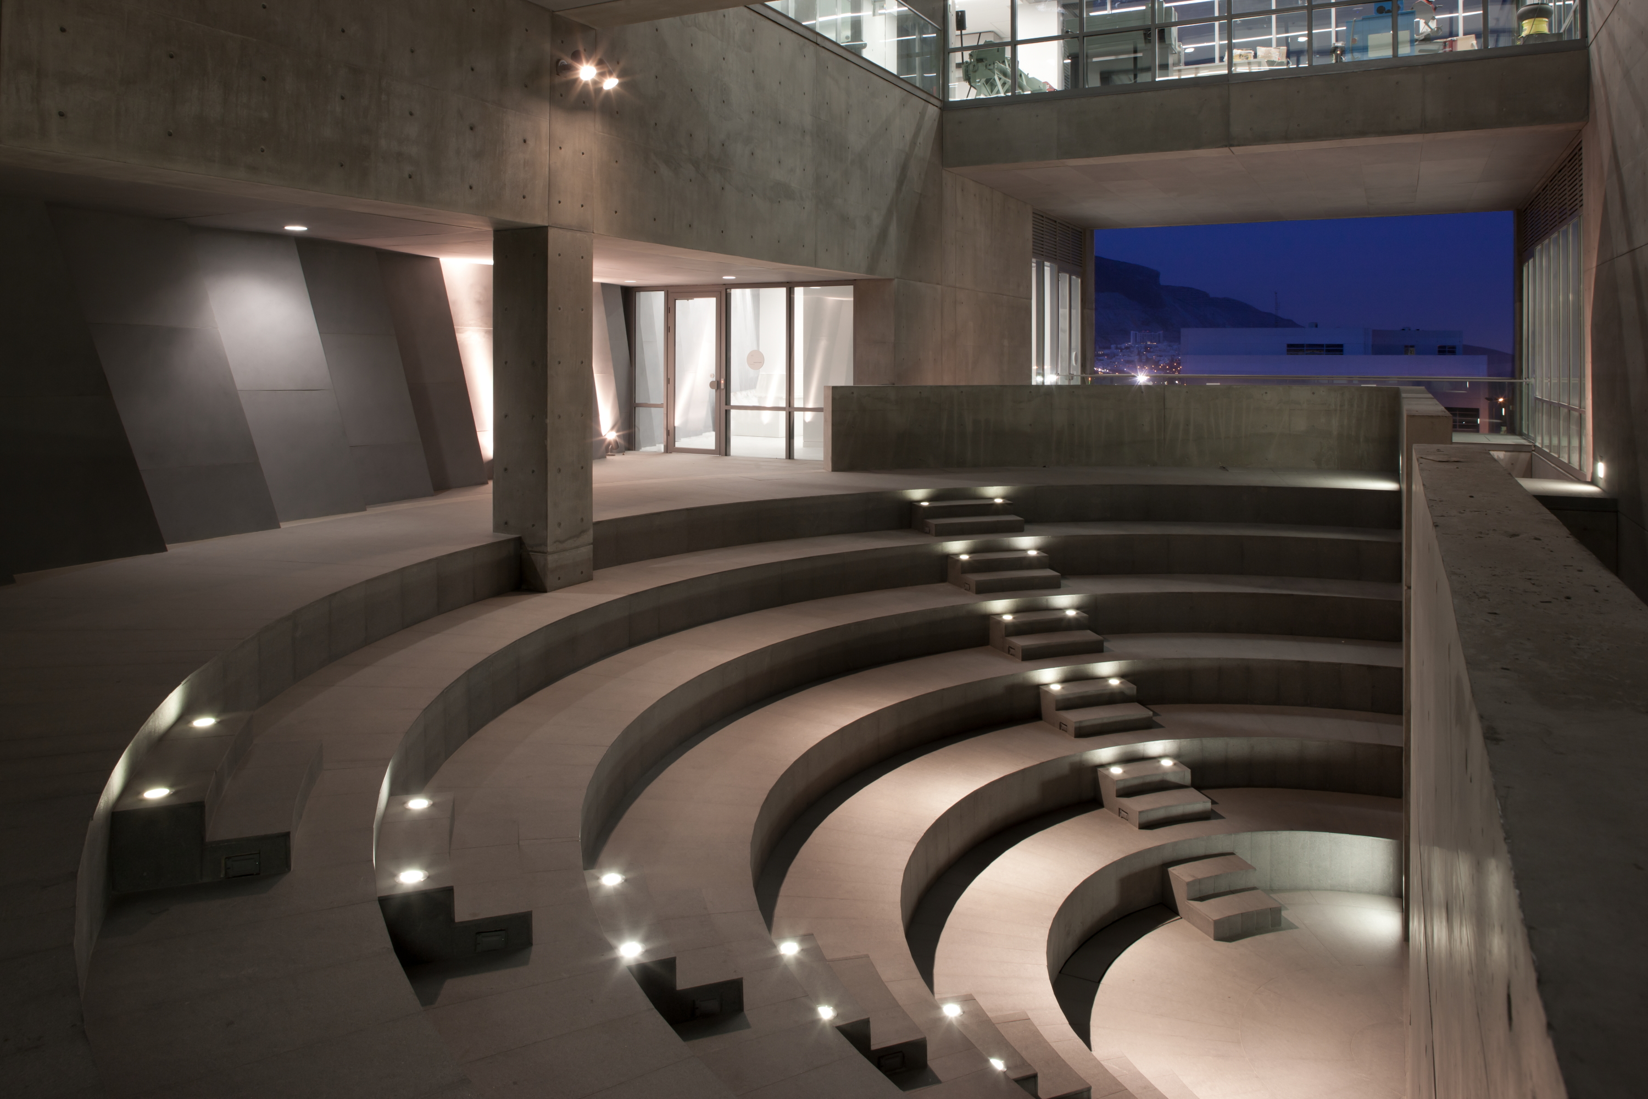





Thank you
For the most up-to-date information, please visit the American Concrete Institute at: www.concrete.org.
Notes:
Please visit ACI’s website at www.Concrete.org.
Featured on the ACI website is the opportunity for engagement with diverse audiences, international audiences, and non-English speaking visitors through built-in site translation into over 70 different languages. The site also features a “Topics in Concrete” section which contains consolidates ACI articles, publications, research, committees, online videos, and other learning tools, on over 100 of the most popular concrete topics.
Connnect with ACI on Facebook, Twitter, and any other channel in which you are active. To receive daily updates on breaking news and innovations in the concrete industry, subscribe to the daily digital news digest, the Concrete SmartBrief.
Thank you for taking these few moments to learn about ACI. If you have any questions, I’d be pleased to talk with you further.

