Slide 1
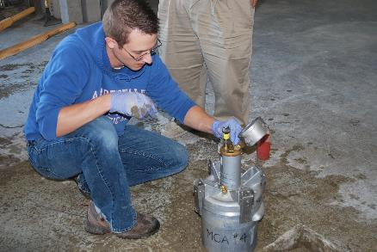
ACI Certifications Overview
Notes:
This set of slides presents an overview of ACI and it’s operations. It touches on most facets of ACI, and as such, users will likely want to edit it to the needs of a specific audience and the speaker’s own style of presentation. For any given presentation slides may need to be added and existing slides either hidden or deleted. It is anticipated that this “base” presentation will grow over time as users request slides on specific topic areas. Thus, this slide set is intended to be more like a library of slides that will serve as a resource document to future users. Please send comments, edits, or suggestions for additional slides to Ron.Burg@Concrete.org.

Slide 2
20 PROGRAMS
Various Levels:
Installer, Technician, Specialist, Inspector
Laboratory
Technician
Adhesive
Anchor
Installation
Field
Technician
Tilt-Up
Aggregate
Technician
Shotcrete
Nozzleman
Craftsman
Inspector
Masonry
Technician

Slide 3
PEOPLE BE
CERTIFIED?
WHY
SHOULD

Slide 4
REQUIRED FOR EMPLOYMENT
INCREASE YOUR
MARKETABILITY
1
2

Slide 5
PREPARE FOR EXAMS?
WHAT MATERIALS ARE OFFERED TO HELP

Slide 6
Workbooks * Prep Material * Training Videos * E-Learning

Slide 7
CERTIFICATIONS
OFFERED IN
OTHER LANGUAGES
?
ARE

Slide 8
Spanish
French
Chinese

Slide 9
WHERE ARE
CERTIFICATION
PROGRAMS HELD
?

Slide 10
North America
Middle East
Asia Pacific
Mexico/Latin America

Slide 11
CERTIFICATION
PROGRAM
NEAR ME?
IS THERE A

Slide 12
http://www.concrete.org/events/eventscalendar.aspx

Slide 13
VISIT CONCRETE.org
Click on Certification!

Slide 15
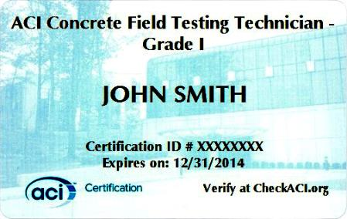
CONGRATULATIONS!

Slide 16
ACI
CERTIFICATION
@ concrete.org
LEARN MORE
ABOUT

