Slide 1
<Your name>
An ACI Ambassador
A Few Moments About the American Concrete Institute
Notes:
<Add presenter’s name to slide.>
NOTE TO ACI AMBASSADOR: These slides are meant to be used as a tool to help you articulate the vision and select programs/services of the American Concrete Institute. These slides should be customized, as appropriate, based on the content of the event/conference, audience demographics, etc. The speaker’s notes are intended to be a guide for your remarks, and should be customized to suit your comfort and presentation style. For additional content about ACI and its programs/services to be used in your slides, or for additional help in generating/customizing your presentation, please contact:
Kevin P. Mlutkowski, LEED AP BD+C
Director, Sustainability & Marketing
American Concrete Institute
1.248.848.3716 | kevin.mlutkowski@www.concrete.org

Slide 2
ACI envisions a future where everyone has the knowledge needed to use concrete effectively to meet the demands of a changing world.
* * * * *
ACI develops, disseminates, and advances the adoption of its consensus-based knowledge on concrete and its uses.
Notes:
Founded in 1904 and headquartered in Farmington Hills, Michigan, USA, the American Concrete Institute is a leading authority and resource worldwide for the development and distribution of consensus-based standards, technical resources, educational programs, and proven expertise for individuals and organizations involved in concrete design, construction, and materials, who share a commitment to pursuing the best use of concrete.
ACI envisions a future where everyone has the knowledge needed to use concrete effectively to meet the demands of a changing world. To accomplish this, ACI develops and disseminates consensus-based knowledge on concrete and its uses.
<Insert additional personal remarks on global access to ACI content based on geography of the presentation. Use local projects, local code efforts, local research, etc., as examples, as appropriate.>

Slide 3





Membership
Networking
Conventions
Chapters
Technical Documents
Publications
Concrete International
Journals
Certification Training
Certification Exams
ACI University
Webinars
Online Learning
ACI Foundation
Research
Scholarships
Thought Leadership
Notes:
At its core, the American Concrete Institute is an organization of individuals dedicated to the best use of concrete. These individuals are members of the Institute, network with each other in person and digitally, attend ACI conventions held twice annually, and participate in and lead ACI’s global network of chapters.
Developing consensus-based knowledge on concrete and its uses is the reason most individuals seek out and contribute to ACI’s vast knowledge. By publishing digital and printed editions of hundreds of technical document/publications, a monthly magazine Concrete International, and two bi-monthly Journals, the Institute shares its consensus-based knowledge with the global concrete community. And, interestingly, all of these technical resources, as well as resources from dozens of similar international institutes, are accessible through www.concrete.org.
Since 1980, ACI has certified over 400,000 individuals through its certification program. From popular programs such as Flatwork Finisher and Field Testing Technician, to specialty programs such as Adhesive Anchor Installer, Concrete Construction Special Inspector, and the new Masonry Testing Technician programs, ACI certification provides a minimum qualification for personnel employed within the concrete construction industry.
ACI University combines all of ACI's online educational offerings in one location and makes them more convenient to access, even on mobile devices. With this immediate access to courses covering ACI's technical documents, preparation for ACI certifications, webinars on a variety of concrete-related topics, and study programs on concrete design requirements, concrete professionals can obtain education from an internationally recognized leader in a more easily accessible manner than ever before.
The ACI Foundation is a not-for-profit organization established by the American Concrete Institute to promote progress, innovation, and collaboration by supporting research and scholarships, while also serving as an independent resource to provide thought leadership and strategic direction for the concrete industry.

Slide 4
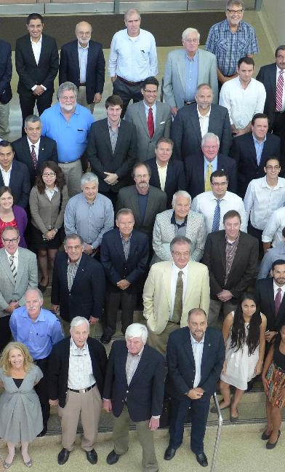
An Institute of Members & Chapters
Over 20,000 Institute members from 129 countries
Plus about 14,500 members from ACI’s 165+ Chapters and Student Chapters
Engineers, researchers, students, contractors, architects, educators, manufacturers, producers, government, and more
Notes:
ACI’s inclusive, member-driven structure and valuable, cost-effective benefits result in an essential organization that invites partnerships and welcomes all concrete professionals who wish to be part of a respected, connected, social group that provides an opportunity for professional growth, networking and enjoyment. As I mentioned earlier, at its core, the American Concrete Institute is an organization of individuals dedicated to the best use of concrete. The Institute is fortunate to share knowledge with and learn from over 18,000 Institute members, plus an additional 20,000 members of ACI’s local chapters. The composition of ACI membership is as diverse demographically as it is geographically, representing many, many concrete related fields with members in 120 countries worldwide–if you aren’t a member, I encourage you to look into our Institute.
And, if you know any students studying in concrete and engineering fields, student membership is completely free!

Slide 5

My Involvement with ACI
<Insert remarks on a personal story, committee involvement, reasons you became a member, attending an ACI convention, etc., or similar>
<insert your photo here>
<Your name>
<“ACI Member,” or “ACI Fellow,” or “ACI Honorary Member,” etc.>
<Highlights of ACI committees, published papers, etc.>
Notes:
<Add personal remarks to slide>
<Add name, ACI membership, committees, etc., to slide>
<Add personal photo to slide>
While it is helpful to understand the breadth of engagement with the American Concrete Institute, I’d like to share with you one specific story about how the American Concrete Institute has had an impact. An impact on me. <Insert additional personal remarks here>

Slide 6





Thank you
For the most up-to-date information, please visit the American Concrete Institute at: www.concrete.org.
Notes:
In conclusion, I’d like to encourage you to visit ACI’s website at www.concrete.org.
In particular, one highlight of the ACI website I’d like to point you to is the opportunity for engagement with diverse audiences, international audiences, and non-English speaking visitors through built-in site translation into over 70 different languages. Plus, the site’s “Topics in Concrete” section consolidates ACI articles, publications, research, committees, online videos, and other learning tools, on over 100 of the most popular concrete topics.
Through social media, please connect with ACI on Facebook, Twitter, and any other channel in which you are active. To receive daily updates on breaking news and innovations in the concrete industry, subscribe to the daily digital news digest, the Concrete SmartBrief.
Thank you for taking these few moments to learn about ACI. If you have any questions, I’d be pleased to talk with you further.

