Slide 1
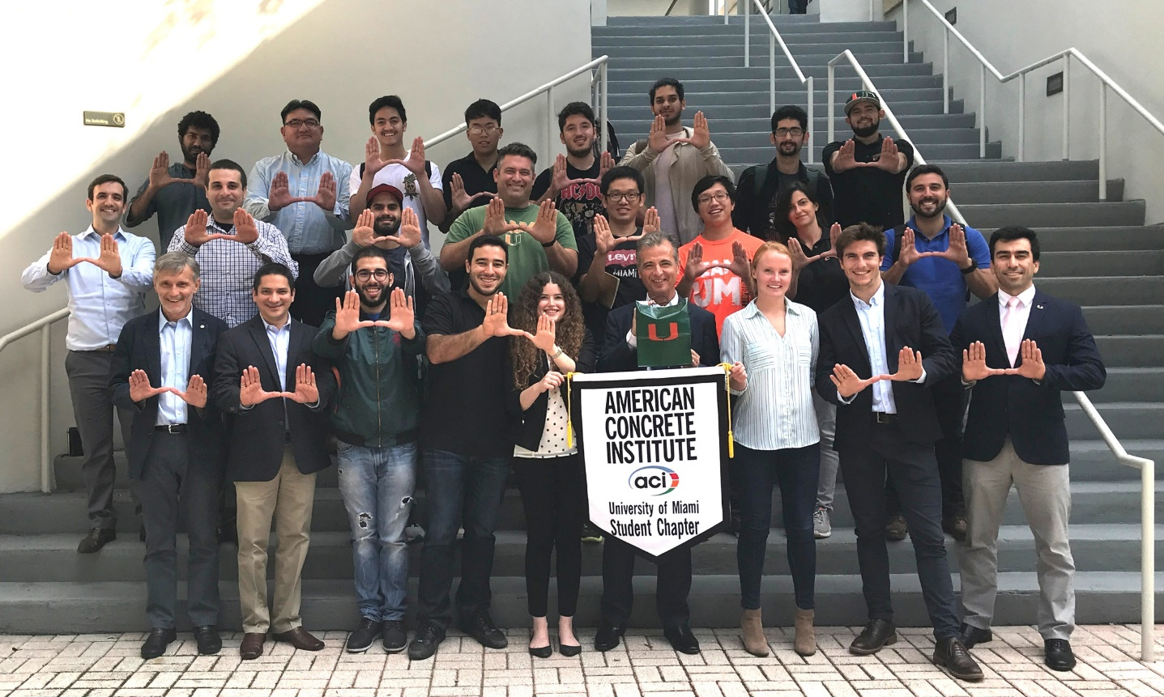
How can I start a new Student Chapter?
Alvaro Ruiz Emparanza
PhD Student
University of Miami

Slide 2
Alvaro Ruiz Emparanza - PhD Student, University of Miami
https://anarchitectsdiary.wordpress.com/tag/motivation/

Slide 3
Documents needed:
Organizing Petition
Bylaw
Sponsorship
Advisor
https://www.istockphoto.com/photos/simplicity
Alvaro Ruiz Emparanza - PhD Student, University of Miami

Slide 4
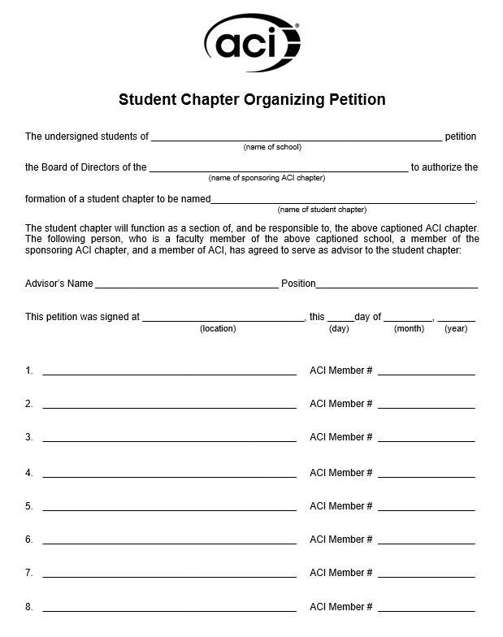
1- Organizing Petition:
Minimum 15 students
ACI membership required (free for students):
http://www.concrete.org/Membership/StudentMembership.aspx.
Alvaro Ruiz Emparanza - PhD Student, University of Miami

Slide 5
2- Bylaws:
Submit a draft of their proposed bylaws
A model available for guidance
Alvaro Ruiz Emparanza - PhD Student, University of Miami

Slide 6
3- Sponsorship:
Letter of approval and support from the local Chapter, acknowledging sponsorship and mentorship to the student chapter. If there is no local chapter in the area, a letter of approval from the department dean is acceptable.
4- Advisor:
University advisor
Member of the local Chapter
ACI member
In case he/she is not a member, a free one-year ACI membership will be provided: https://www.concrete.org/educatorsandresearchers/facultynetwork.aspx
Alvaro Ruiz Emparanza - PhD Student, University of Miami

Slide 7
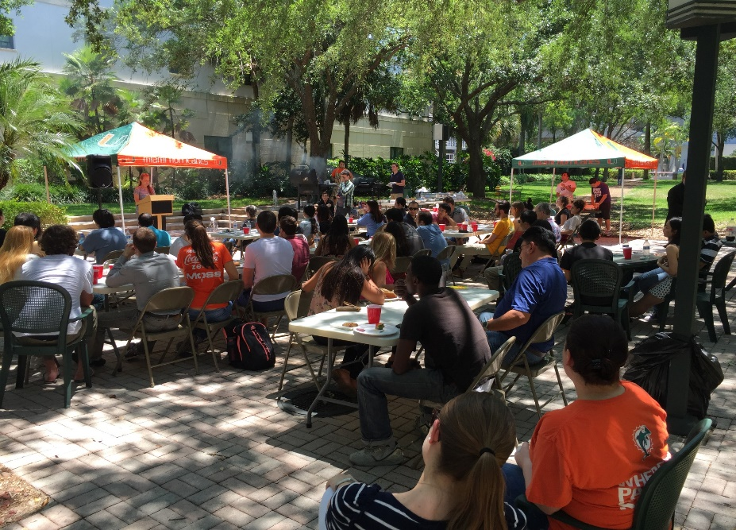
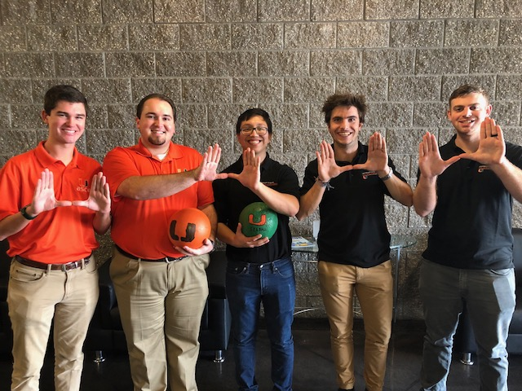
Student Activities
Social Events and Community Service
Student concrete competitions
Seminars, Workshops, Site Visits
Alvaro Ruiz Emparanza - PhD Student, University of Miami

Slide 8
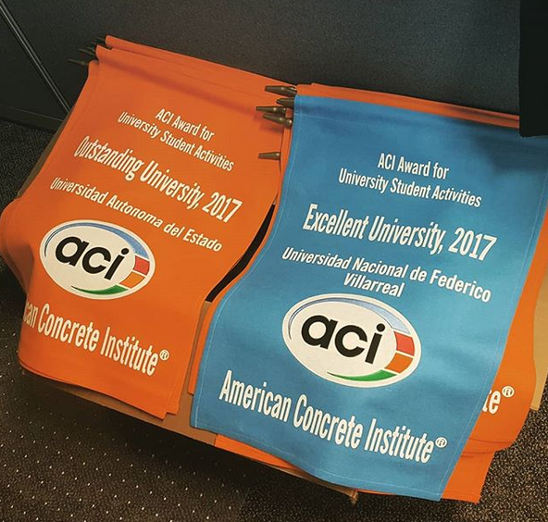
ACI Award for University Student Activities
Recipients of the ACI Award for University Student Activities receive a physical and electronic award banner and are recognized during the ACI Spring Concrete Convention and Exposition and featured in Concrete International magazine.
Applications due January 31
Learn More
www.concrete.org/students/universityaward
Alvaro Ruiz Emparanza
PhD Student
University of Miami

Slide 9
Any question?
Alvaro Ruiz Emparanza
PhD Student
University of Miami

Slide 10
https://commons.wikimedia.org/wiki/File:Thank-you-word-cloud.jpg
Alvaro Ruiz Emparanza
PhD Student
University of Miami

