Slide 1
ADVANCE YOUR FUTURE WITH ACI
Students Today Are Tomorrow’s Concrete Industry Leaders

Slide 2
What is American Concrete Institute?
Founded in 1904
Nonprofit technical and educational society
Leading authority on concrete and concrete technology

Slide 3
Who are ACI members?
20,000
Members
Worldwide
5,000
Student
Members
Notes:
The 1956 Convention was in Montreal, QC, Canada.

Slide 4
Everyone interested in concrete
Engineers
Educators
Contractors
Architects
Students
Technicians

Slide 5
ADVANCE YOUR EDUCATION

Slide 6
SCHOLARSHIPS
FELLOWSHIPS
Stipend up to $15,000
Undergraduate/Graduate
Up to $3,000
Regional & Global
Paid travel to ACI Conventions
Internships and Mentorships

Slide 7
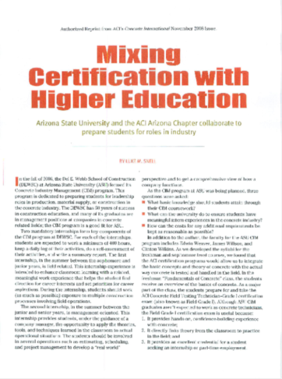
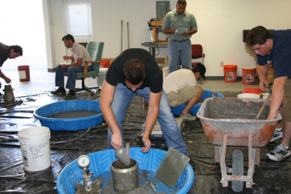
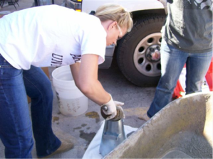
ACI Certification (Over 20 programs)
Notes:
Accessed from the ACI website (www.concrete.org) under the “Publications” tab.

Slide 8
The Reorganized ACI 318-14:
Benefits, Availability
and Rationale
Do you know the code?

Slide 9
ADVANCE YOUR KNOWLEDGE
Notes:
Accessed from the ACI website (www.concrete.org) under the “Publications” tab.

Slide 10
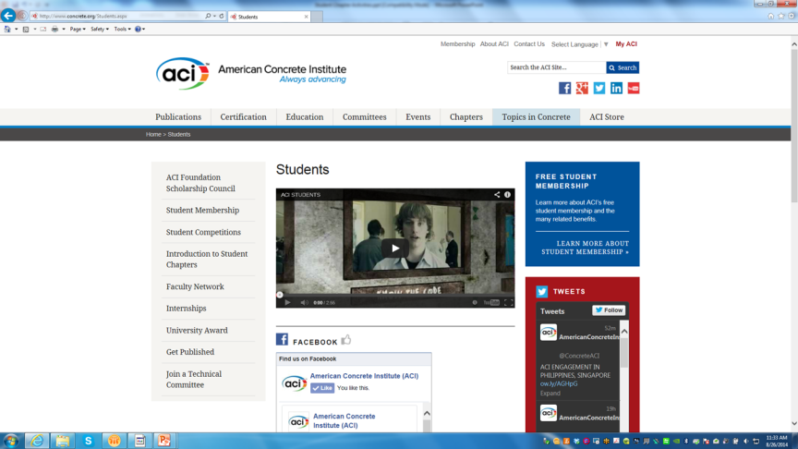
FREE Student E-Membership
Notes:
Accessed from the ACI website (www.concrete.org) under the “Publications” tab.

Slide 11
Online
Earn CEUs
100+ Concrete topics
Download documents
Watch webinars

Slide 12
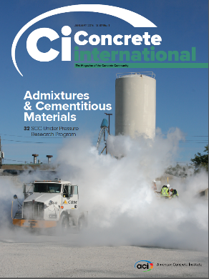
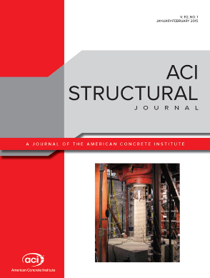
FREE Industry Publications (also available online)
Get published in CI or ACI Journals!

Slide 13
ADVANCE YOUR EXPERIENCE

Slide 14
CAREER CENTER Hundreds of Internships and Job Opportunities!
www.concrete.org/careercenter

Slide 15
Discounted Registration to ACI Conventions
Regular price $469
Students pay $10

Slide 16
HANDS-ON EXPERIENCE Student Concrete Competitions
Bowling Ball Competition
Egg Protection Device
Canoe Competition
Up to $750 in prizes

Slide 17
ADVANCE YOUR RELATIONSHIPS

Slide 18
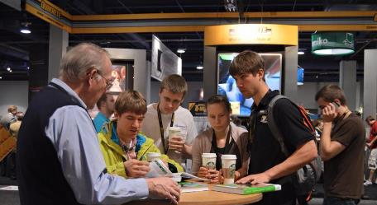
Chapters are important to ACI!
109 Student Chapters
57 Domestic
52 International
Notes:
There is a total of about 18,500 chapter members, 4000 of which are ACI members.

Slide 19
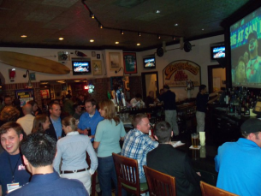
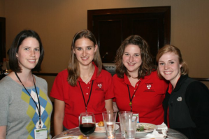
Typical Chapter Activities
Educational Seminars
Program Meetings
Social Activities
Networking/ Mentorship
Award Programs
Tours/Field Trips
Social Activities
Community Service Projects
Notes:
These are just a few examples of technical committee reports that might be of interest to engineers and contractors involved with the design or construction of hydroelectric plants.

Slide 20
ACTIVATE YOUR FREE E-MEMBERSHIP SECURE YOUR FUTURE TODAY!
Join us at www.concrete.org!

Slide 21
,

